Slide 1


Slide 2
Finding your customers online
Startup and Online Market
Build a Launch Page
Test and Evaluate using Google AdWords

Slide 3
Why do start-ups fail?
Building something NO ONE wants
“Life is too short to keep building something nobody (or not enough people) want” – Ash Maurya
The biggest risk of a startup is not failing, but wasting years of your life with an idea that will go nowhere

Slide 4
Example: Review site for Mechanics
Car mechanic industry is broken:
  Very low transparency
  High commissions
  High variability in service quality
  Many poor experiences
  Over budget services
Ripe for disruption with our fancy Web 2.0 app?
Make revenue on affiliate, sponsored ads, etc

Slide 5
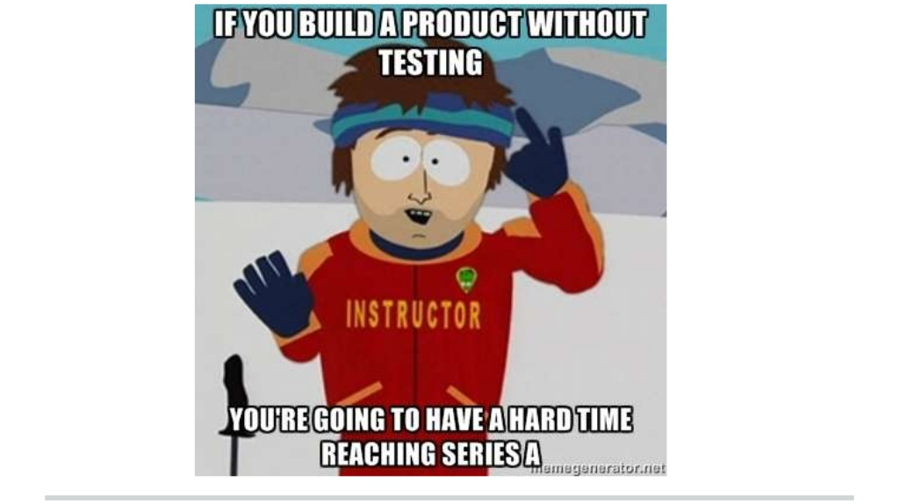
Wrong!

Slide 6
Wrong – Validate your hypotheses
Do people have a problem with their current mechanic?
  Maybe I have been visiting mine for the past 20 years
What are the target demographics for dissatisfied car owners?
  Do they use the internet to solve this problem?
  Are they likely to post reviews and engage?
What do people care about when they see a car mechanic?
  Price, speed, quality, experience, convenience?
Do I see a mechanic often enough to care?

Slide 7
Product meets market
What is the core problem?
Most, if not all, of your assumptions will be proven totally or partially incorrect
Why waste months building something that doesn’t solve a (painful enough) problem?
Ideas are cheap, your life isn’t!

Slide 8
Funnel of Demand
People who like your product
People who would use your product
People who actually use your product
People who would pay for your product
People who actually pay for your product
People who pay for your product now
People who have paid you
People who continue to pay you

Slide 9
Reduce Market Risk
Test and validate as many market risks as possible before writing a single line of code
Secure pre-payment before the product is finished
Self fund your startup
Negotiate better terms with investors
Sleep better at night

Slide 10
Lean Startup
Not covered in tonight’s session
Lean Methodology – Eric Ries
Running Lean – Ash Maurya
Startup Owner’s Manual – Steve Blank

Slide 11
Building a Launch Page
Mini (fake) sales website
Pretend you have a working product fully built with screenshots, quotes, pricing, sign up, etc
Watch behavior of real website visitors as they click through your website, browse and signup
Track your users and conversion metrics to see if users will actually buy the product

Slide 12
Launch Page - Tools
Launchrock – free tool to build your first launch page
Google Analytics – critical that you are actually measuring what happens
Wordpress / Themeforest – use Wordpress for a more professional launch page and Themeforest to buy the theme

Slide 13
Launch Page – What to include
Mini sales site should include the following:
  Home
  Product Tour / Screenshots (optional)
  Pricing
  Sign up
Home page should have a list of features and a Call to Action (Try or Buy)

Slide 14
Questions?
Notes:
There is no better way to learn how to be an entrepreneur than jumping in with both feet!
Meet fellow students and potential co-founders

